Slide 1


FINAL ASSESSMENT EXCEL FUNDAMENTALS
RANJANIPRIYA D
LVADSUSR179

Slide 2

1.AVERAGE TIME LEAD BETWEEN THE REQUEST DATE AND THE COMPLETION DATE
The average number of lead time between the request date and the completion date is approximately 28 days

Slide 3
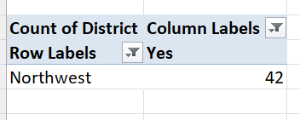
2.District with highest number of rush jobs
The highest number of rush jobs is in northwest with a count of 42

Slide 4
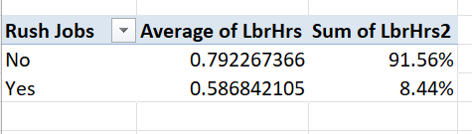
3.Average labour hrs differ from rush and non-rush jobs
The rush jobs hold almost 9% from the jobs available and there are almost 92% jobs available without rush.
And in a count the average labour hours is depicted below

Slide 5

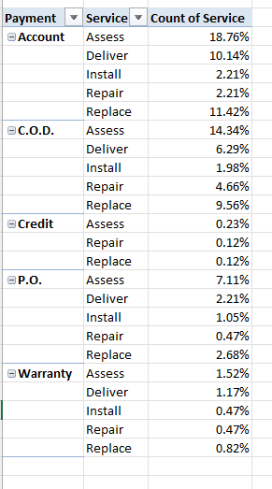
4.Distribution of payments type over the services
The payment type “accounts”with the service type “Assess” has the highest distribution of all data holding a percent of nearly 19% of the whole data.
Whereas under credit payment there is no holdings for the types of service such as assess,repair and replace and the warranty payment type has no holdings in install and repair

Slide 6

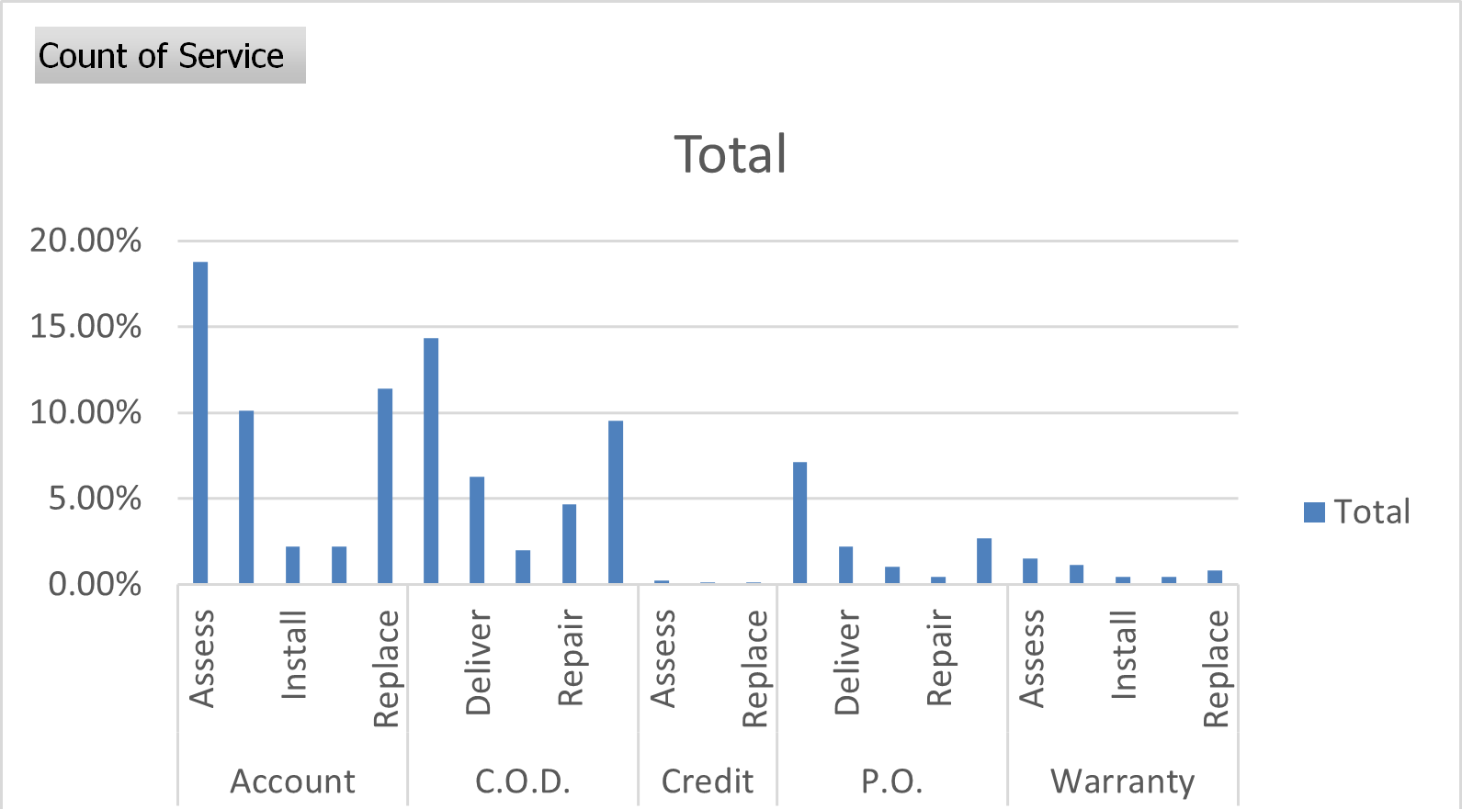

Slide 7
5.Trends in the distribution of payments
The number of payments done under the payment type “Accounts “ hold the maximum count of 384 orders.
The least number of orders received is 4 and it is of credit payment type.

Slide 8
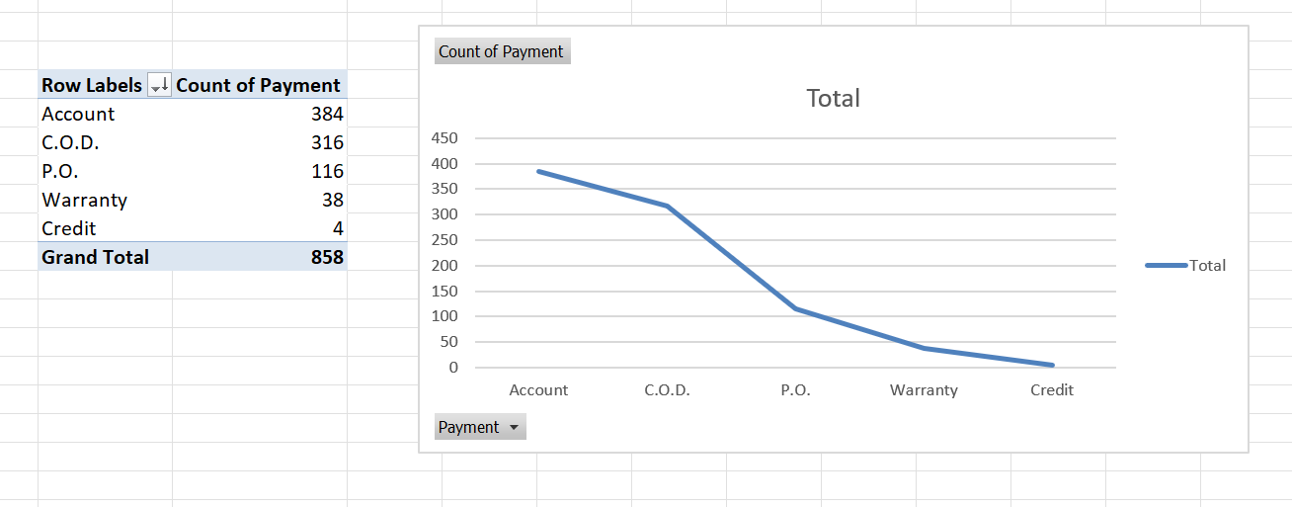

Slide 9
6.The number of techs required and the payment cost
There is a need for the high amount of payment if the tech person is single and if it increase the payment cost reduces.
If considering the average cost for person, then three tech people has the highest average and it is 132.75

Slide 10
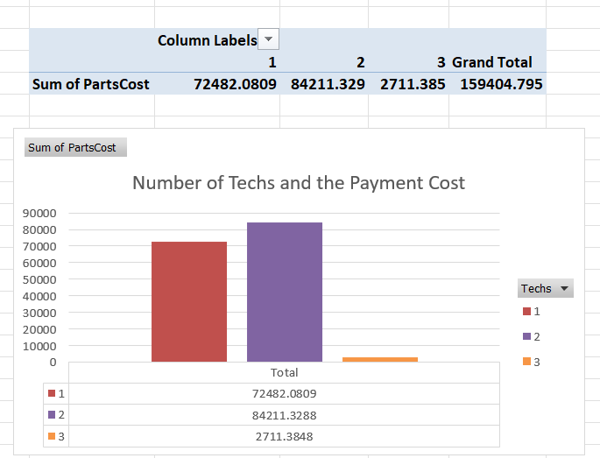

Slide 11
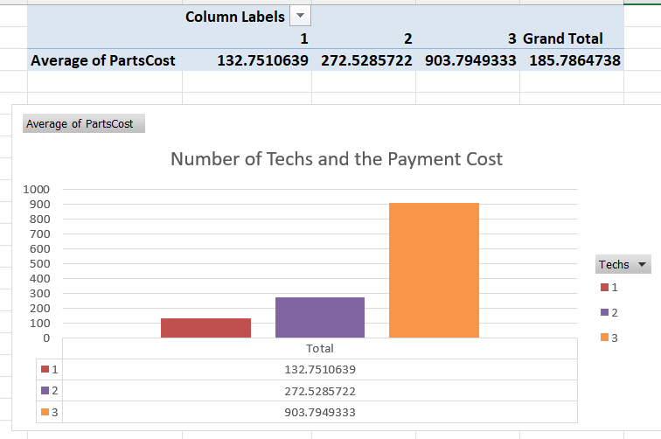

Slide 12
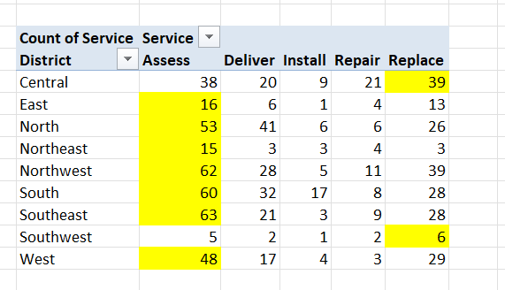
7.Common type of service requested in each district
The below slide has the highest count of service asked in different districts and top one was the assess service in south east district

Slide 13
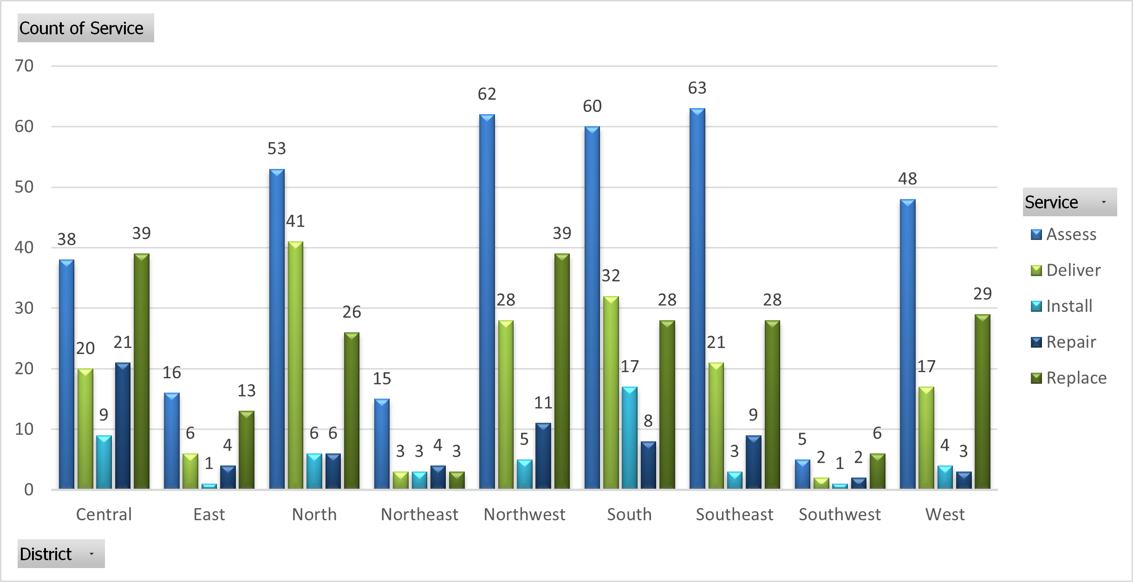

Slide 14
8.Difference in the distribution of payments for work orders with the warranty labour compare to those without
THERE IS A HIGH PERCENT OF ORDERS WITHOUT WARRANTY LABOUR ALMOST 96%
THE ORDERS WITH WARRANTY LABOUR ALMOST HOLDS 5% OF THE WHOLE ORDERS.

Slide 15
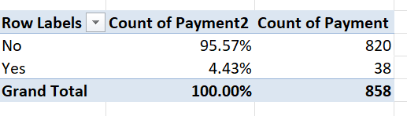

Slide 16
9. INTERACTIVE dashboard
For the work_order dataset

Slide 17
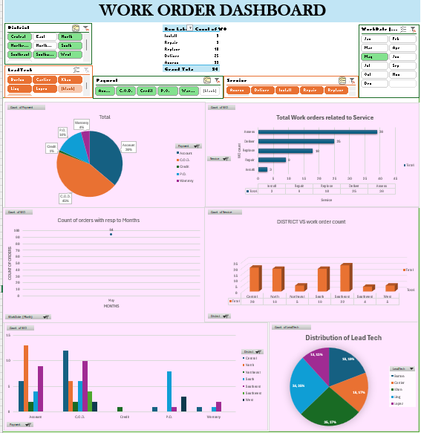

Slide 18
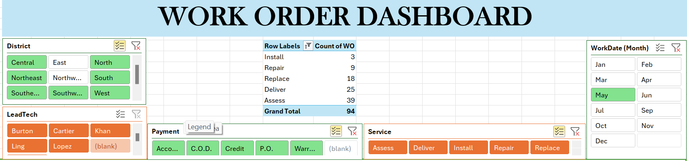

Slide 19
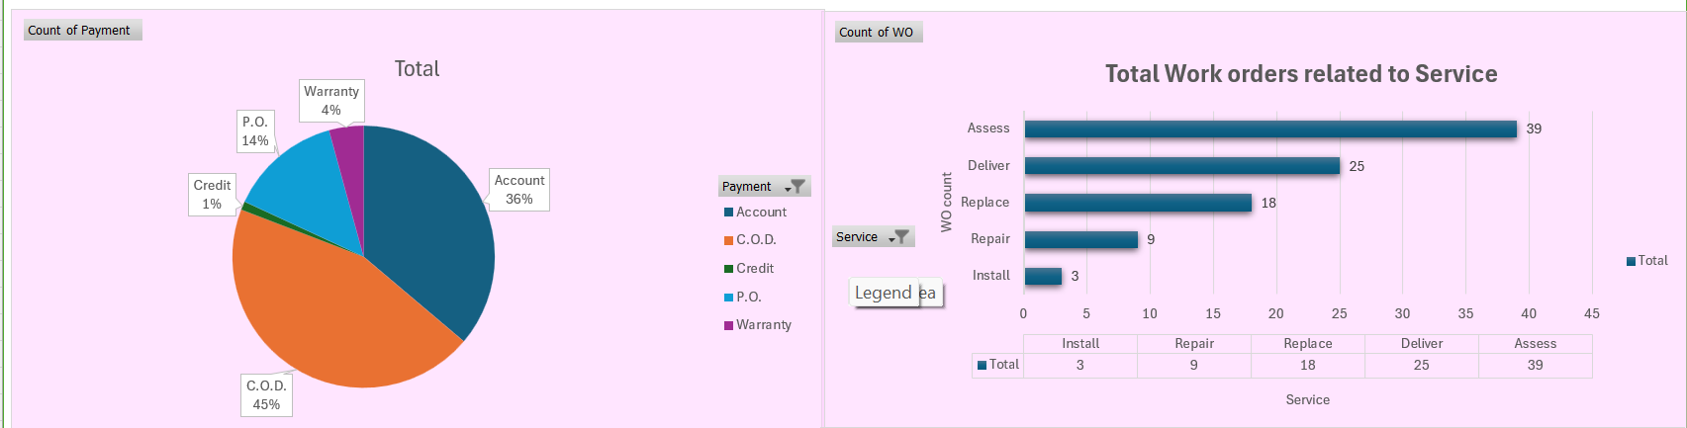

Slide 20
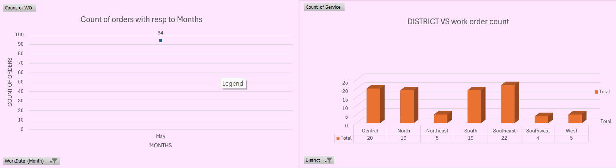

Slide 21
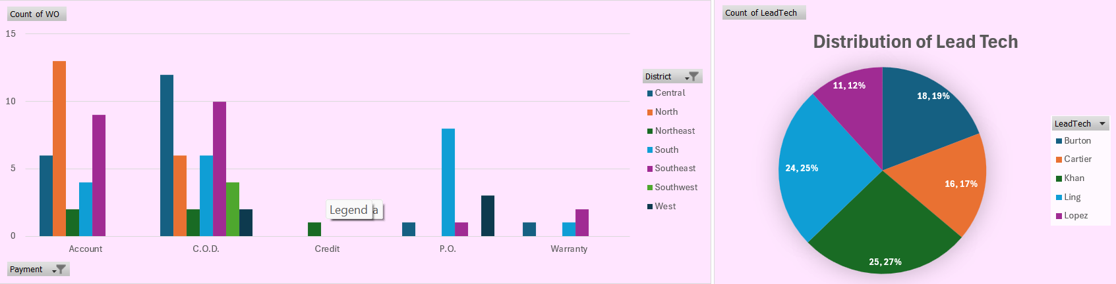

Slide 22
INFERENCE FROM THE DASHBOARD
COMPARING THE DISTRICT AND PAYMENT WITH THE ORDER COUNT, WE GET A HIGHER ORDER COUNT IN THE DISTRICT NORTH WITH THE PAYMENT TYPE ACCOUNTS
THE LEAD TECH KHAN ATTENDS MOST OF THE ORDERS THAT HAS BEEN RECEIVED.
THE WORK ORDERS FROM SOUTH AND NORTHWEST IS THE HIGHEST IN RECEIVING THE ORDERS WITH A COUNT OF 145 ORDERS EACH.
MOST OF THE ORDERS BELONG TO THE PAYMENT TYPE ACCOUNTS (45%)
THE MONTH JUNE HAS THE HIGHEST NUMBER OF ORDERS WHICH IS 145
THE SERVICE THAT IS MOST COMMON IN WORK ORDERS IS ASSESS WITH A COUNT OF 360.

Slide 23
MEASURES CAN BE TAKEN
PROMOTING THE WORK ORDERS IN THE REGION OF SOUTH WEST AND EAST AND ATTRACTING PEOPLE TO GET MORE WORK ORDERS.

